Slide 1

P147 - Telecommunications Churn Prediction
TEAM MEMBERS:
Abhilash G
Karan S
Shivam V
Ashutosh M

Slide 2
Business Problem:
Customer churn is a big problem for telecommunications companies. Indeed, their annual churn rates are usually higher than 10%.
For that reason, they develop strategies to keep as many clients as possible.
This is a classification project since the variable to be predicted is binary (churn or loyal customer).
Objective:
In this project, we will analyze customer-level data of a telecom firm, build predictive models to identify customers at high risk of churn and identify the main indicators of churn.
The goal here is to model churn probability, conditioned on the customer features.

Slide 3
Architecture level analysis :
Understand the business statement
EDA
Outlier Detection and Treatment.
Feature Engineering.
Model Building
Deployment through Stream-lit.

Slide 4
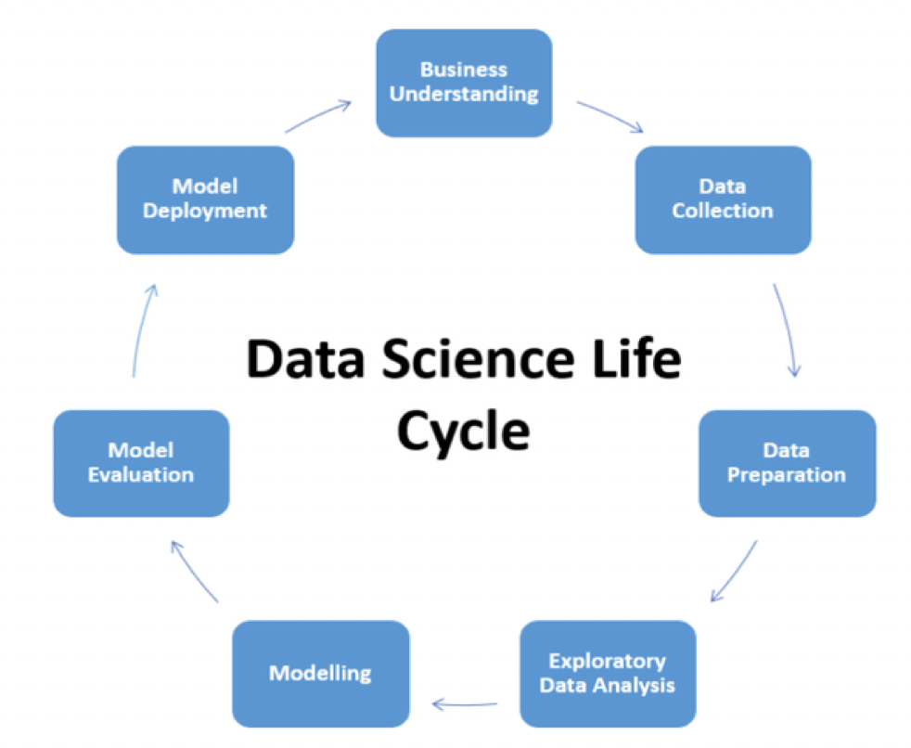
Project Architecture / Project Flow

Slide 5
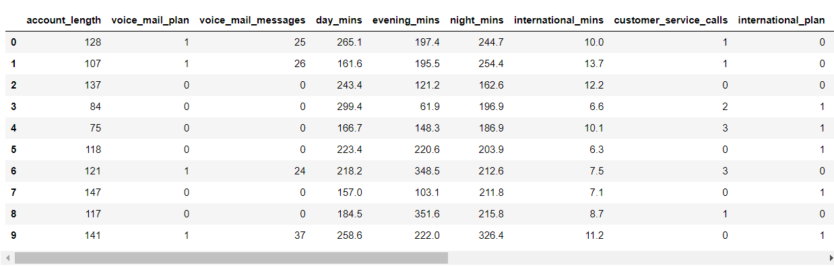
Data set details:
This dataset is about predicting whether a customer will change telecommunications provider, something known as "churning".
The training dataset contains 3333 samples. Each sample contains 18 features and 1 boolean variable "churn" which indicates the class of the sample.
The given data does not contain any 'nan' values hence we don't have any missing values, also the data types are correct.
In that 19 columns there are 10 integer type and 9 floating type.
The given data does not contain any duplicate rows.

Slide 6
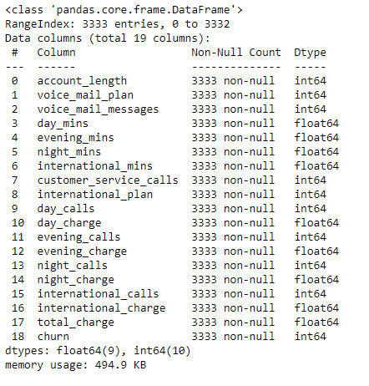


Slide 7
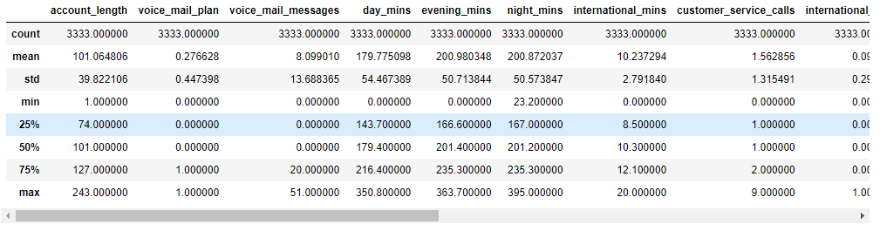
Exploratory Data Analysis (EDA):
The mean value and the median value (50% percentile) are not having much difference between them for all the columns except the four discrete columns which are voice_mail_plan, voice_mail_messages, international_plan, and churn.

Slide 8
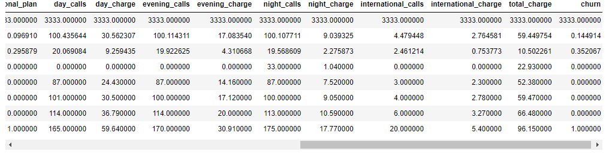
Exploratory Data Analysis (EDA):
For account length, voice mail messages, customer service calls, & international calls the max value is almost double to the 75% percentile value. For the remaining columns there is not a big difference in the 75% value and max value.
From observations 1 and 2, it looks like the given data is somewhat symmetric. And, we can say there is a chance of outlier in account length, voice mail messages, customer service calls, & international calls columns. But we will be confirming that below with the help of histogram and boxplot.

Slide 9
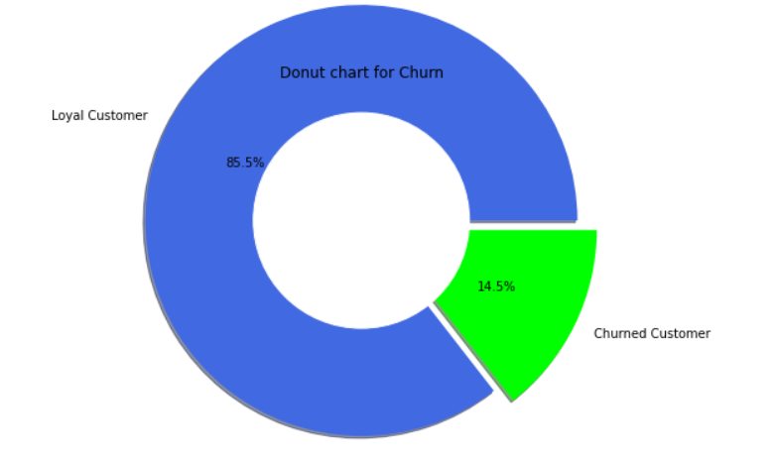
Analysis of the given Target variable “CHURN”:
In the given data only 483 (14.5%) customers are the churn customers.
In the given data only 2850 (85.5%) customers are the loyal customers.
From observations 1 and 2 we can say that there is a significant imbalance in the two classes of data.

Slide 10
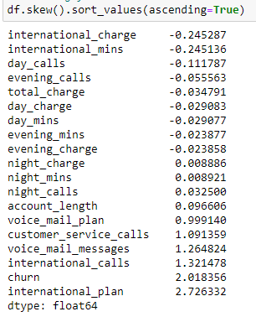
Checking for Skewness in data set:
International_charge and international_mins has Negative Skewness
Voice_mail_plan, customer_service_calls, voice_mail_messages, international_calls, churn and international_plan has Positive Skewness

Slide 11
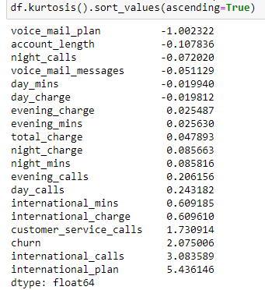
Checking for Kurtosis in data set:
Voice_mail_plan has Negative Kurtosis
Day_calls, international_mins, international_charge, customer_service_calls, churn, international_calls, international_plan has Positive Kurtosis

Slide 12
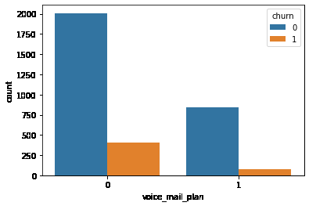
Analysing Voice Mail Plan:
From the Above graphical representation we can clearly see that Customers with No Voice_mail Plan has higher Churn rate.

Slide 13
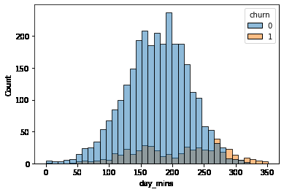
Analysing day_Mins:
From the Above graphical representation we can clearly see that Higher Churn is found in customers with day_mins around 100 to 280.

Slide 14
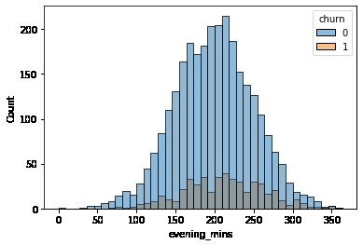
Analysing evening_Mins:
From the Above graphical representation we can clearly see that Higher Churn is found in customers with evening_mins around 130 to 300.

Slide 15
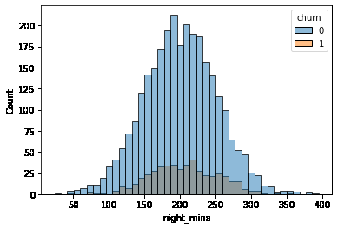
Analysing night_Mins:
From the Above graphical representation we can clearly see that Higher Churn is found in customers with night_mins around 120 to 280.

Slide 16
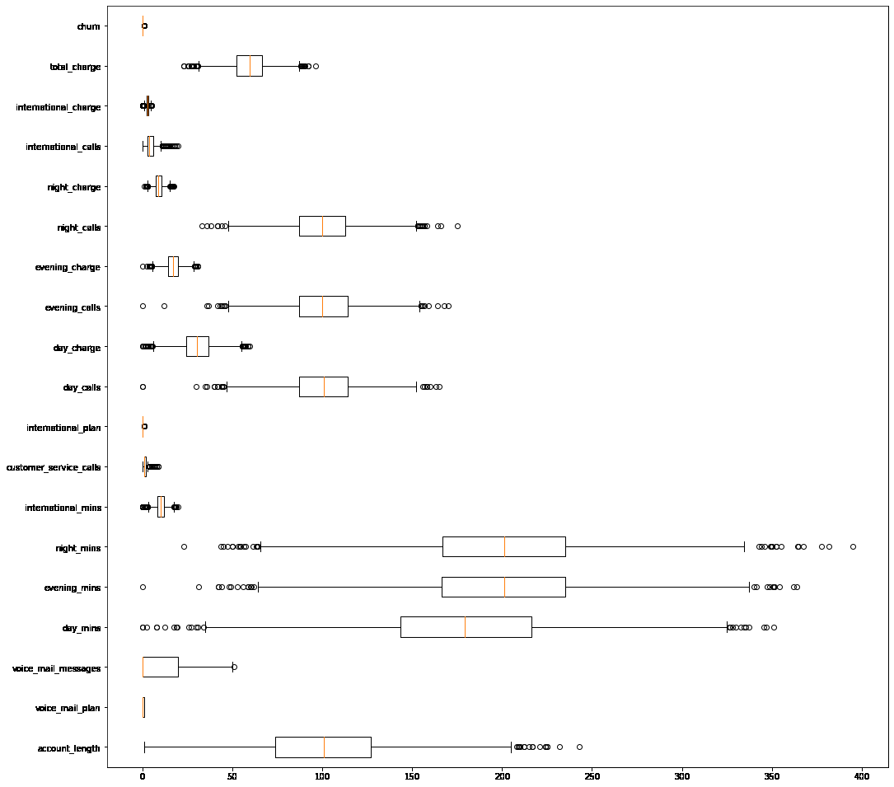
Outlier Detection:

Slide 17
Outlier Detection:
Account_length has Outliers in Lower Quartile
Voice_mail_messages has Outliers in Upper Quartile
Day_mins has Outliers in Both Upper and Lower Quartile
Evening_mins has Outliers in Both Upper and Lower Quartile
Night_mins has Outliers in Both Upper and Lower Quartile
International_mins has Outliers in Both Upper and Lower Quartile
Customer_service_calls has Outliers in Upper Quartile
International_plan has Outliers in Upper Quartile
Day_calls has Outliers in Both Upper and Lower Quartile
Day_charge has Outliers in Both Upper and Lower Quartile
Evening_calls has Outliers in Both Upper and Lower Quartile
Evening_charge has Outliers in Both Upper and Lower Quartile
Customer_service_calls has Outliers in Upper Quartile
Night_calls has Outliers in Both Upper and Lower Quartile
Night_charge has Outliers in Both Upper and Lower Quartile
International_calls has Outliers in Upper Quartile
International_charge has Outliers in Both Upper and Lower Quartile
Total_charge has Outliers in Both Upper and Lower Quartile

Slide 18
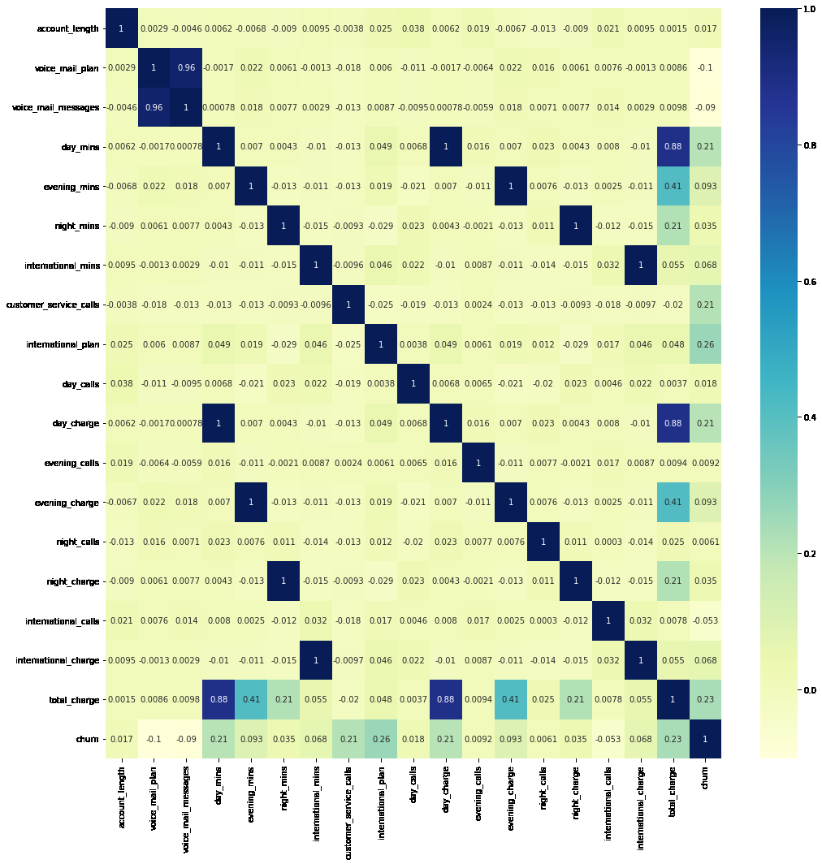
Detecting Multicollinearity:

Slide 19
Detecting Multicollinearity:
Voice_mail_plan & voice_mail_messages has Strong Correlation with value 0.96
Total Charge & Day_min has a Strong Correlation with value 0.87
Total Charge & Evening_min, Evening_Charges has a Weak Correlation.

